Slide 1
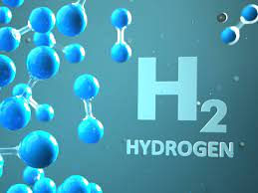
Tax Credits for Blue Hydrogen under The Inflation Reduction Act of 2022
Kentucky Hydrogen Summit Blue Gas in the Bluegrass
Stephen D. Berger
Wyatt, Tarrant & Combs, LLP
January 25, 2023

Slide 2
Hydrogen is an invisible, odorless, colorless gas, but…
Those in the energy business refer to H₂ by an array of colors as shorthand for how the H₂ is produced, including the following terms used in this presentation:
The Color Palate of Hydrogen
 | Green | Blue | Grey
Process | Hydrolysis | Steam Methane Reforming | Steam Methane Reforming
Feedstock | H₂0 | Natural gas | Natural gas
Process Energy | Renewable electricity (solar, wind, hydropower) | Natural gas | Natural gas
C0₂ emissions | None | CO₂ used, or captured and sequestered (CCUS) | CO₂ emitted into the atmosphere

Slide 3
Clean Hydrogen PTC
The Inflation Reduction Act of 2022 (the “Act”) amends the Internal Revenue Code (the “IRC”) to add a new Section 45V, which provides a production tax credit (the “Clean Hydrogen PTC” or the “Credit”) for the production of “qualified clean hydrogen” for each taxable year during the 10-year period commencing on the date the “qualified clean hydrogen facility” is placed in service.

Slide 4
Clean Hydrogen PTC (cont’d.)
Base Amount of the Credit
The base amount of the credit in any taxable year equals $0.60/kg (adjusted annually for inflation)
of “clean hydrogen” produced multiplied by the applicable percentage shown below, based on the
resulting greenhouse gas emissions rate.
Greenhouse Gas Emissions Rate (kg of CO₂ produced per kg of H₂ produced) | Applicable Percentage
2.5 – 4.0 kg | 20%
1.5 – 2.5 kg | 25%
0.45 – 1.5 kg | 33.4%
0 kg – 0.45 kg | 100%

Slide 5
Clean Hydrogen PTC (cont’d.)
The Act defines “qualified clean hydrogen” as hydrogen that is produced through a process that results in a greenhouse gas emissions rate, as determined under the Clean Air Act, through the completion of production not greater than four kilograms of CO₂ equivalent per kilogram of hydrogen.
The hydrogen must be produced in the United States (or a possession of the United States) for sale, or for use, in the taxpayer’s ordinary course of business.
The production, and sale or use, of the hydrogen must be verified by an unrelated third party. No official guidance has yet been issued interpreting this requirement.
Notes:
The inclusion of “use”, in addition to “sale”, is significant, since it allows taxpayers to claim a production tax credit (“PTC”) for producing qualified clean hydrogen even if the clean hydrogen is not sold to an unrelated party, which had previously been a requirement to claim a PTC.

Slide 6
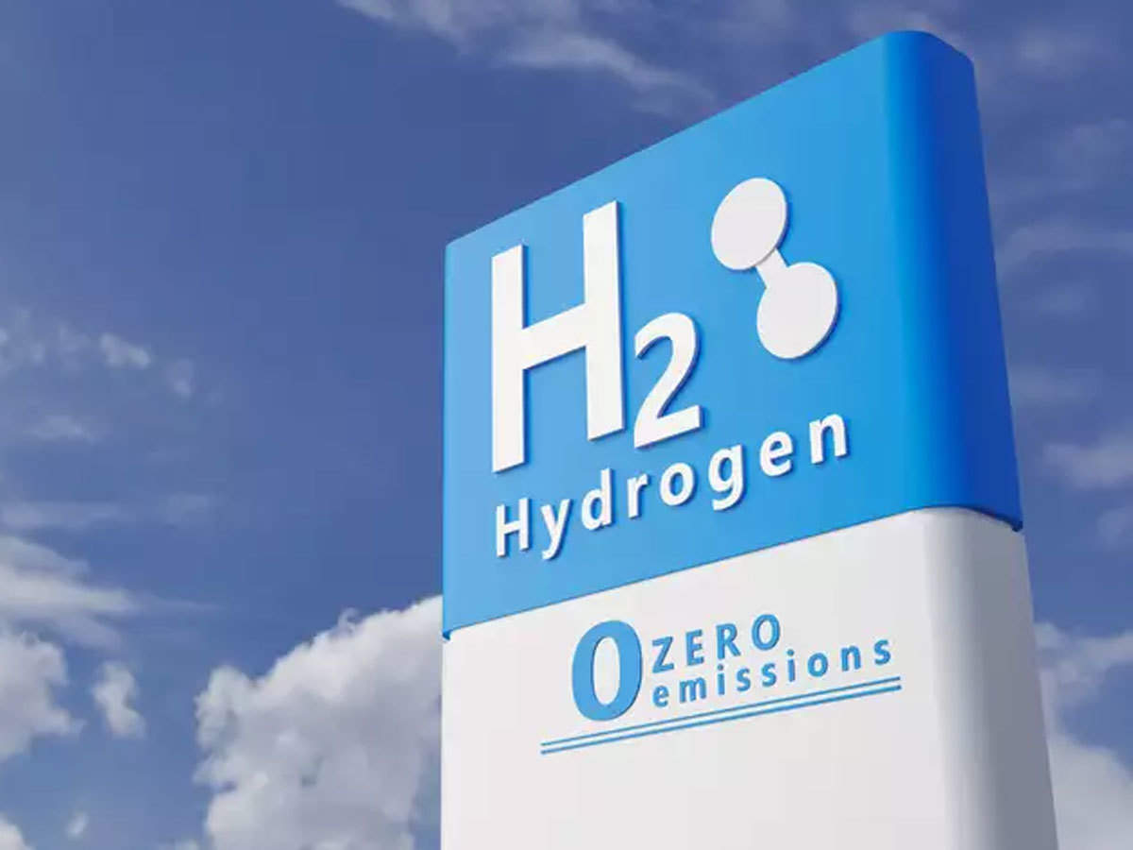
Clean Hydrogen PTC (cont’d.)
The Act defines a “qualified clean hydrogen production facility” as a facility:
owned by the taxpayer,
which produces “qualified clean hydrogen”, and
the construction of which begins before January 1, 2033.
To be “qualified clean hydrogen”, the hydrogen must be produced through a process that results in a greenhouse gas emissions rate of not greater than 4 kilograms of CO₂e per kilogram of hydrogen.
CO₂e (carbon dioxide equivalent) means the number of metric tons of CO₂ or other greenhouse gases emitted with the same global warming potential as one metric ton of CO₂.

Slide 7
Clean Hydrogen PTC (cont’d.)
Increased Credit
The Base Credit described above is multiplied by 5 if the qualified clean hydrogen production facility satisfies the following requirements:
Prevailing Wages
Apprenticeship

Slide 8
Clean hydrogen PTC (cont’d.)
Prevailing Wage Requirement
Workers employed by the taxpayer, or by any contractor or subcontractor, in the construction of the qualified clean hydrogen production facility must be paid not less than the prevailing wage rates for similar construction, as most recently determined by the U. S. Secretary of Labor for the locality where the facility is located.

Slide 9
Clean hydrogen PTC (cont’d.)
Apprenticeship Requirement
Each taxpayer, contractor, or subcontractor who employs four or more individuals to perform construction of a qualified clean hydrogen production facility must employ to perform the work employees participating in an apprenticeship program registered with the U.S. Department of Labor (DOL) or applicable state government agency (“qualifying apprentices”).
Of the total labor hours performed in the construction of such a facility the construction of which begins (i) before 2023, 10%, (ii) during 2023, 12.5%, or (iii) after 2023, 15%, must be performed by qualifying apprentices.
The work must be performed in compliance with any applicable requirements for apprentice-to-journeyworker ratios of the DOL or state agency.

Slide 10
Clean hydrogen PTC (cont’d.)
Credit Reduced for Tax-Exempt Bonds
If the qualified clean hydrogen production facility is financed in whole or in part with tax-exempt bonds, the amount of the Credit is reduced by the lesser of (i) 15% or (ii) the proportion of the total cost of the facility financed by the tax-exempt bonds.

Slide 11
No Double Dipping
No Clean Hydrogen PTC may be claimed with respect to any qualified clean hydrogen produced at a facility which includes carbon capture equipment for which a credit is allowed to any taxpayer under IRC §45Q for the taxable year or any prior taxable year.

Slide 12
Clean Hydrogen PTC (cont’d.)
Refundable Credit
The owner of a qualified clean hydrogen production facility may elect on its tax return for the year in which the facility is placed in service to treat the Clean Hydrogen PTC to which it is entitled in that year and all subsequent taxable years ending before January 1, 2033 as if it were a tax payment and, to the extent the credit exceeds the tax liability for any such year absent the credit, may claim the excess as a tax refund.

Slide 13
Monetization of the Clean Hydrogen Production Tax Credit
IRC § 6417— Direct Pay Credit
IRC § 6418— Transferability of the Credit

Slide 14
IRC §6417
Direct Pay Credit
The Act adds IRC §6417, which allows “applicable entities” to make an election to treat the Credit as a payment of tax by such entity for the taxable year with respect to which such the Credit was determined.

Slide 15
IRC §6417 (cont’d.)
“Applicable entities” include:
State or political subdivision thereof,
Tennessee Valley Authority,
Indian tribal government,
Alaska Native Corporation,
rural electric cooperative, and
any other organization exempt from Federal income tax.
IRC §6417 allows any such “applicable entity” to utilize and monetize a Clean Hydrogen PTC via a tax refund, even though as tax-exempt entities such entities generally do not incur tax liabilities.

Slide 16
IRC §6417 (cont’d.)
Any taxpayer (i.e., individuals and entities subject to Federal income tax) may elect in the year a qualified clean hydrogen production facility is placed in service to be treated as an “applicable entity” and to treat the amount of the Clean Hydrogen PTC to which the entity is entitled in the year the facility is placed in service and for each of the four subsequent taxable years ending before January 1, 2033 as a payment of Federal income tax and, to the extent such amount exceeds the tax liability for such year if the taxpayer is an individual or C corporation, to claim the excess as a tax refund.
The Credit may be carried back for three years and unused Credit may be carried forward 22 years.

Slide 17
IRC §6417 (cont’d.)
If the entity is a partnership or an S corporation, an election to sell all or a portion of the Credit is made at the partnership or S corporation level and the seller receives from the IRS a cash payment equal to the amount of the Credit sold.
An election under IRC §6417 is made on a facility-by-facility basis with respect to each separate qualified clean hydrogen production facility owned by the applicable entity in the year such facility is placed in service.

Slide 18
IRC §6418
Transferability of the Credit
The Act adds IRC §6418, which allows an “eligible taxpayer” to transfer all or a portion of its Clean Hydrogen PTC to a “transferee taxpayer”.
Any taxpayer, other than an “applicable entity” (as defined under §6417) may be an “eligible taxpayer”, except that the “transferee taxpayer” may not be related to the “eligible taxpayer” by more than 50% common ownership.
A transferee taxpayer need not have a trade or business or otherwise be involved in the renewable energy industry.

Slide 19
IRC §6418 (cont’d.)
If an “eligible taxpayer” is a partnership or an S corporation, the election to transfer the Credit is made at the partnership or S corporation level.
Eligible Credits may not be transferred more than once.
Payments for the transfer must be made in cash and are not included in the gross income of the selling taxpayer nor deductible by the transferee taxpayer.
The election to transfer must be made by the due date (including extension) for the tax return for the year in which the Credit is determined and may not be revoked.

Slide 20
Epilogue
Today, almost all of the hydrogen produced for industrial use – primarily, in refineries and manufacturing plants – is so-called Gray Hydrogen, derived principally from natural gas, and its production results in the production of large volumes of CO₂.
Producing more environmentally friendly Blue Hydrogen requires capturing the CO₂ and disposing of it in some manner, such as sequestering it deep underground, or using it in some beneficial manner, such as in advanced oil recovery.
Green Hydrogen, on the other hand, is produced via electrolysis, the process of separating water into hydrogen and oxygen. When the electricity used in the process comes from renewable sources, such as wind, solar, or hydropower, the result is zero-carbon hydrogen.
Today, green hydrogen is the most expensive form of hydrogen to produce, two to three times more expensive than blue hydrogen, according to a recent report from the International Renewable Energy Agency. However, green hydrogen production costs are expected to substantially decrease in next decade, with improved electrolysis technology and the scaling up of that technology to industrial levels of production. Until then, taking advantage of the incentives available under The Inflation Reduction Act of 2022, production of blue hydrogen appears to be the most practical and cost-effective alternative.
101023548.1

